Slide 1
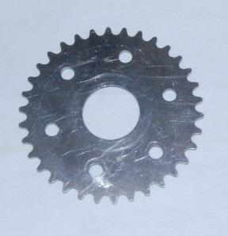
Robotics Belts, Chains, Sprockets and Gears
LabRat Scientific
© 2018

Slide 2
When designing a robot, it will be necessary to transfer the motion and power generated by a motor to devices such as wheels, spinning devices, or arms. There are several ways to accomplish this: Belts and Pulleys, Chains and Sprockets, or Gear Systems.
These systems can also be used to increase or decrease rotational speed and change the torque of the system.

Slide 3
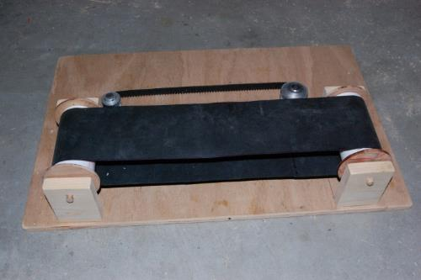
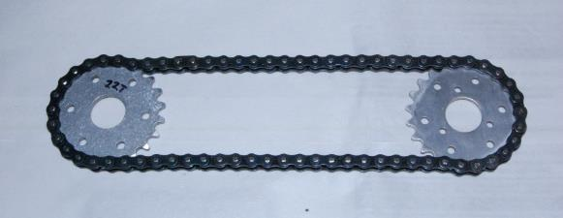
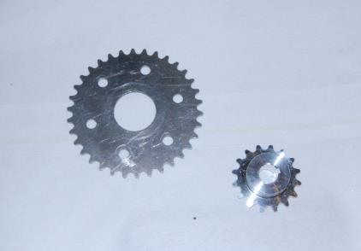
Components
Drive Chain
Conveyor Belt
Drive Belt (toothed)
Sprockets

Slide 4
Applications
Transmit power or rotation over a distance…
Move an object back and forth in a linear fashion…
Alter torque and rotational speeds

Slide 5
Picking up a Ball
A pair of belts can be used to puck up a ball. When the belts rotate in one direction, they will draw the ball in. When the belts are reversed, they will push the ball out.
Wide, flat belts can be used or a series of parallel narrow bands (surgical tubing) can be used. Both have been used successfully.

Slide 6
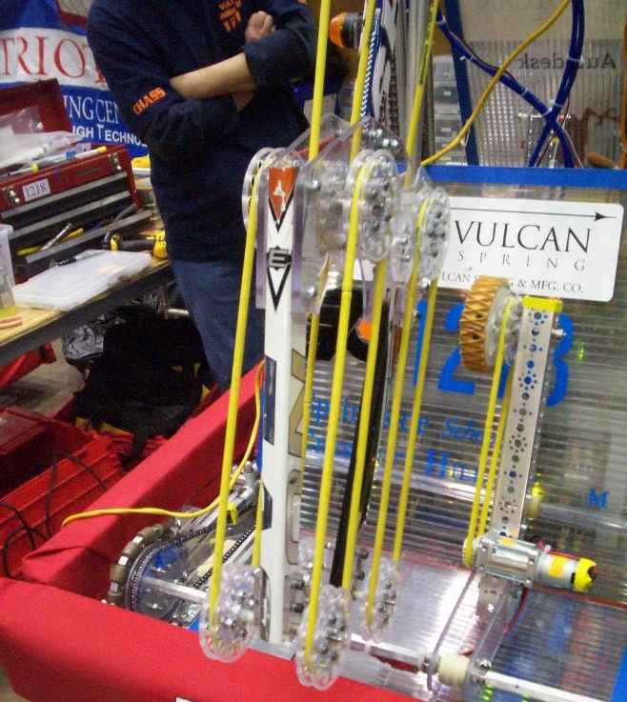
Surgical Tubing
The system depicted here is used ot move balls within the robot. The distance between pulleys can’t be too far because the tubing will spread apart and not grip the ball properly.

Slide 7
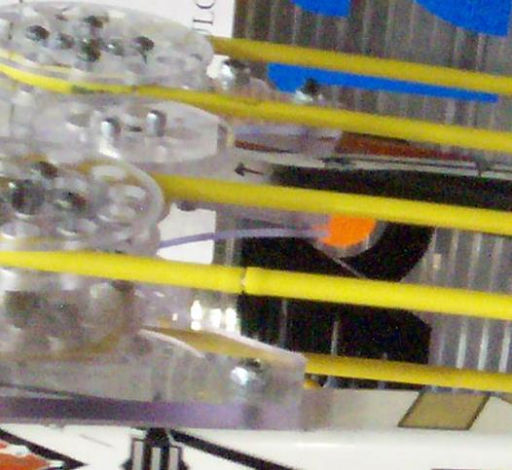
Surgical Tubing Coupler
Surgical tubing is hollow. A small wood or plastic dowel can be inserted in the open ends of the tube to serve as a coupler.
If the fit is tight enough, the dowels can secure the tube by themselves. It may be necessary to use tape or wire rings to keep the tube from slipping off.

Slide 8
Pulleys and Sprockets are essentially the same thing. Pulleys are used in conjunction with belts, and sprockets are used in conjunction with chains.
Chains and sprockets provide much more positive engagement and the system will not slip. Belts and pulleys much be tight to the belt doesn’t slip.
Gears work in the same way, but there is no need for belts or chains to connect them. Gears interact directly with one another.

Slide 9
Changing the diameters of the sprockets or pulleys will result in changes in rotational speed and delivered torque. This is discussed in the following slides.

Slide 10
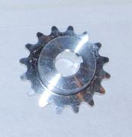
Sprocket Ratios
34
16
15
30
5
25
10
5
10
16
Ratio = -------- = 0.47
34
20
15
34
Ratio = -------- = 2.125
16

Slide 11
Nomenclature
SECONDARY SPROCKET
The sprocket that is driven by force in the chain created by the primary sprocket
PRIMARY SPROCKET
The sprocket that is attached to the power generating device (i.e. motor). It creates the tension (force) in the chain.

Slide 12
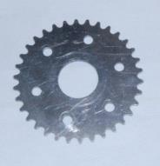
Sample Problem
Primary Sprocket: 30 teeth
Secondary Sprocket: 15 teeth
Primary
If the motor turning the primary sprocket is turning at 100 rev/min, how fast will the secondary sprocket be spinning?
30 teeth
Sprocket Ratio = ---------------- = 2
15 teeth
Secondary Rotational Speed = Primary Rotational speed x Sprocket Ratio
200 rev/min = 100 rev/min x 2

Slide 13
Effect of Sprocket Ratio
Effect on Free Sprocket
Speed: Increases
Torque: Decreases
SECONDARY SROCKET
PRIMARY SPROCKET
Speed: Decreases
Torque: Increases
PRIMARY SROCKET
SECONDARY SROCKET

Slide 14
Effect of Sprocket Ratio
Primary Sprocket
Puts heavier initial mechanical load on the motor
Initial motor current draw will be high
Results in low acceleration
Not good for zipping back and forth
Provides high top-end speed
Good if you need high speed over long distance
Not good for hill/ramp climbing

Slide 15
Effect of Sprocket Ratio
Primary Sprocket
Results in low initial mechanical load on the motor
Current load minimized
Can provide best acceleration if sprocket ratio is optimized
Good if lots of starting and stopping is required
Results in low top-end speed
Good for hill/ramp climbing

